Slide 1
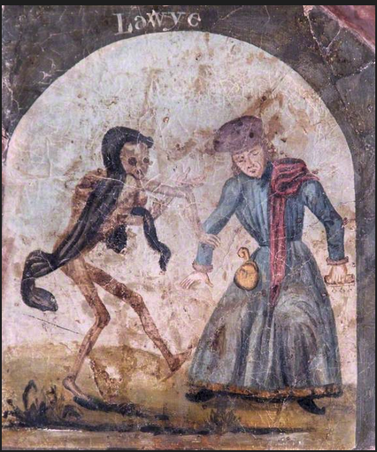
Social Listening and Infodemic— An Epidemiology for the Body Politic
Conference: Governance of Social Listening in the Context of Serious Health Threats
University of Hong Kong
Remarks 22 August 2023
Larry Catá Backer (白 轲)
W. Richard and Mary Eshelman Faculty Scholar; Professor of Law and International Affairs; Pennsylvania State University
The Dance of Death (Death Dancing with a Lawyer)
unknown artist
Oxfordshire County Museums Service

Slide 2
This is an age of epidemic, of pandemic, and now of infodemic.

Slide 3
Infodemic in the digital Age: Principal Characteristics
First is that information is the central element of infodemic as plague.
Second, is that a measurable quantity of information that exceeds a certain unspecified threshold triggers effects detrimental to the human social organism.
Third, is that information combines both analogue and digital sources
Fourth, is that infodemic is constituted in relation to something else of roughly equal magnitude.

Slide 4
Identifiable Symptoms
questions, concerns,
information voids (where people seek credible, accurate information but cannot find it),
circulating MIS- and DIS- information.”
https://www.billhalal.com/blog/misdisinformation/

Slide 5
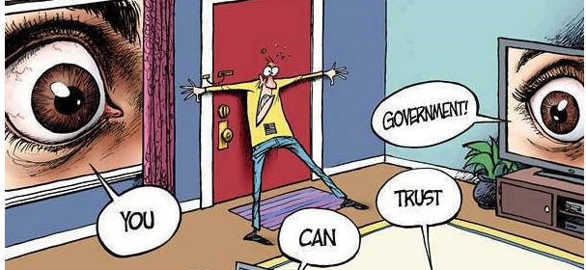
Good Medicine: Social Listening/(社交監聽)
When administered before the onset of physical plague, it can act as a vaccine.
Prevention
Nonetheless it can be administered during the course of the physical disease.
efficacy is tested against its power to alleviate the physical effects of plague—info-, epi- or pan-demic.

Slide 6
Social Listening and Markets
In an August 2023 report, ReportLinker suggested that the social media listening market was expected to grow from $7.41 billion to $14.21 billion between 2023 and 2028

Slide 7
Sentiment Analysis (情感分析)
通过对需要舆情监控的实时文字数据流进行情感倾向性分析，把握用户对热点信息的情感倾向性变化
By analyzing real-time texts that require public opinion monitoring one can carry out emotional tendency analysis on character data streams, and grasp the changes of users' emotional tendency towards hot information

Slide 8
How to Build an Infodemic Insights Report in Six Steps
Focus on the circulatory system of the body politic—its narrative and narrative pathways.
Narrative points to the health of the body politic as a function of the proper operation of its circulatory system
made up of narrative and is itself the paths through which narrative travels

Slide 9
An Epidemiology for a Digital Pestilence
“Even as humanity has been developing its epidemiology in the analogue—the physical realm—so, it appears, that there has there been a strong push to develop a parallel and interlinked epidemiology for the virtual world.”

Slide 10
Vaccine Making in Infodemic—The Production of Truth From Facts
Concept of intelligent naming (明名 (Míng míng))
Drawing distinctions accurately and of extracting truth in the process; and millennia later, of seeking truth from facts (实事求是).
Truth as a function of and related to the facts that have been aggregated as extraction of observation of symptoms; physical symptoms of individuals, and social symptoms of the body politic (Hippocrates)
Inductive versus deductive pathways

Slide 11
Consequences and Challenges For Regulatory Regimes

Slide 12
(1) DIS- or MIS-Information When Produced or Received?
if one hears what one wants or needs to hear, then is it possible to understand the nature of MIS and DIS as relational in the sense that its nature and impact is a function of the interaction between producer and recipient of data clusters with the character of information.
The same applies in the context of generative AI and predictive analytics-based systems.

Slide 13
(2) Beginnings, middle or End
The mechanics of social listening and its implementation takes as a starting point the premises for authoritative action drawn from the core rules of the political-economic order of a place. And so on.

Slide 14
(3) Infodemic Regulatory Self-Reflexivity
By that I mean that no sense of objective or of analysis is possible unless it is undertaken in relation to something. That “something” may be a manifestation of what is at times called ‘objectives’ but which may be better understood as an ideal state of things defined a priori.

Slide 15
(4) Social Listening is a Two-Way Street

Slide 16
(5) Mis- Coordination and Conflict Weakening Infodemic Treatments
“The tragedy of the WHO’s internal bickering during the course of the COVID pandemic suggests that the techniques of social listening not only produce variation at the ground level, but it can substantially impede the work of coordinating bodies.”

Slide 17
(6) Understanding MIS- and DIS- Information
The terms have no solid referent other than from out of the premises, goals, objectives and world views of the entities who relate to information as either positive or negative stimuli in relation to some activity or state of mind that is positively important or threatening to the entity and its enterprise.

Slide 18
(7) Intent Matters
Interpretive discretion at every level of the epidemiology of infodemics, shapes and drives
the mechanisms in courses of treatment,
the data selected,
the identification of targets and objects.
The identification and control of intent has been given its own field of regulation: accountability and compliance.

Slide 19
(8) The Disruptive Effect of Tech
Humanity is barely at the start of a discussion of how this is meant to operate.
Its governing organs have barely, and most crudely have begun a process of building normative structures (articulated as rules) around which that relationship may be advanced.
Meant to mirror AI and physical life forms,; it is not clear that this will work in the long run.

Slide 20
Closing Thoughts
Social listening is an important first step in that direction. But it is not the last. It is, instead, a gateway to better understand, and deploy, hybrid human-tech modalities for social relations in the physical and virtual worlds.
None of this will produce viable regulatory or operational responses—especially respecting human rights and ethics-- if those fail to consider the core issues which, whether they like it or not, will both constrain and drive any such efforts.

Slide 21
Thank You
The text of these remarks may be accessed here or
[http://www.backerinlaw.com/Site/wp-content/uploads/2023/08/Backer_Remarks_Social_Listening_Conference8-2023.pdf]

