Slide 1
Governing Platforms: Structural and Conceptual Challenges
Larry Catá Backer
W. Richard and Mary Eshelman Faculty Scholar Professor of Law and International Affairs
Pennsylvania State University

Slide 2
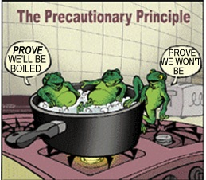
First Principles: Platforms and Ideologies of Regulation
The Reactionary Turn in Regulation
A problem in search of a solution?
Tech as a threat to Orthodox regulatory ordering
A solution in search of a problem?
Tech as the future of regulatory transformation
Points of intervention
Post Facto (Judicial or Private)
Ex Ante (Administrative and institutional)
Point of Regulation:
Problem solving (ad hoc and anarchic--driven by recognition of dissonance or threat)
System building (precautionary and intentional; orthodoxy and norms; absorption of emerging tech into existing systemic forms-objectives)
Instrumentalization of tech-based collectivism—use of tech to problem solve and system build
Risk allocation (extending or re-thinking risk principles to tech)
Accountability ( absorbing tech into emerging regulatory cultures)

Slide 3
Platform as Object and as Language
What are Platforms?
The space where consumers and producers of objects, ideas, or other activity meet to engage in exchanges
The object, ideas, or other activity undertaken in and through constructed spaces
The architecture (physical, abstract, linguistic, logical, etc.) through which such spaces can be manifested, and their integrity protected
The language and meaning making through which such architectures, spaces, and objects can be identified, signified, and embedded in human collectives –e.g., words versus code
The principles around which human activity is rationalized, and protected through rules

Slide 4
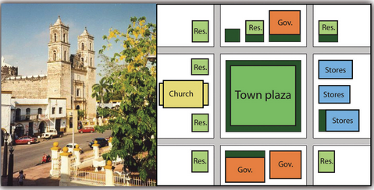
Platforms, the Technologies of Collectivism, and the Architectures of Regulation
Manifestation driven by
Technology
Security
Accessibility/ Transparency
Social organization built around these drives
“Truth from facts”
Rationalization is both built on and builds these manifestations
The architecture of platforms reflects and embeds these rationalizations
The protection of rationalization through law-norms
Protect integrity of architecture and operations
Strategically use rationalization (norms)to “improve” or manage the platform and its operations as well.

Slide 5
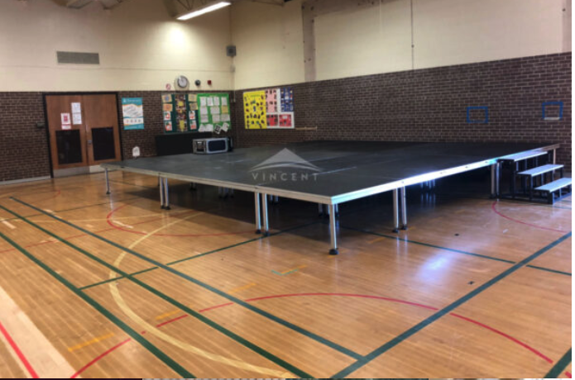
Defining the Field of Regulation
Kinds of Platforms
Administrative Agencies
Rating Agencies
Clearinghouses
Markets
Enterprises
Religious Institutions
Other Spaces created for exchange
Regulation:
--As the constitution of the spaces that define platforms
--As the protector of integrity
--as social engineering
Location
Physical
Virtual
Hybrid

Slide 6
Platform Regulation and Inter-Connectivity: The Smart City
Four levels of regulatory operation
Platform integrity (based on type, function, and manifestation in physical-cyber space). The level of the single platform; operationalization and object integrity issues.
Platform coordination (based on the needs and realities of inter-connectivity grounded in the processes of inputs and outputs). The level of coordination of related platforms along production chains; macro-economics or politics.
Platform Oversight (e.g. smart cities; macro-economic policies; internationalization). The constitutional level of regulation—space where core principles are embedded.
Platform as global disciplinary site (e.g. furthering rationalizing normative premises in cultures of compliance and accountability furthering normative principles of prevent-mitigate-remedy). The level of international/transnational hard and soft law; the focus on convergence around core rationalizing principles and language

Slide 7
Platforms in the Post-Anthropocene: AI & Machine Learning
The regulation of the insertion of the human element in platforms
Risk allocation
Issues of bias (Good versus taboo bias and societal ideals)
Site of intervention
The insertion of values
Accountability measures
Can platforms manage themselves?
Platform governance rules as an operator’s technical Manuel?
Or is the language of coders and modelers now the language of law (see ALI Principles for a Data Economy; Tentative Draft #2 (May 2022).
Regulation moves from operation to oversight
But where is that oversight placed? Public/private/national/international?
Law essential for developing taboo spaces
Borders, objectives, and the transposition of constitutional/social/cultural values into platforms
But that is the risk: fractured politics produces fractured governance

Slide 8
Before One Can Regulate: The Regulatory Conceptual Core
What is it that one is regulating (regulatory object)?
Whose interests are to be protected?
What are the objectives to which regulations are directed?
Where is the regulation and regulatory power sited?
To what extent are accountability and assessment measures effectively embedded, whether quantitative, qualitative or hybrid?
To what ends do the regulations produce coherence with other regulatory measures and align with regulatory aims (data production, norm naturalization, compliance, social engineering, etc.)?

Slide 9
What is regulated object?
The platform itself
The activities in the platform
The objects produced and consumed (data, information, copies, aggregations, access, interpretation, projections outward, etc.) through platforms
The relations among platforms

Slide 10
Whose Interests?
The international order
The constitutional order
The political-economic order (liberal democratic versus Marxist-Leninist; versus theocratic, etc.)
Producers
Consumers
Suppliers
The nexus and system of inter-relations

Slide 11
To What Ends
Greater glory of the political-economic order
Greater glory of the societal-normative-moral order
Risk allocation
Boundary setting (taboos)
Practices; the insertion of the human
Standards
Accountability/Assessment as against standards or targets
Instrumental (the use of the platform for something other than the purpose to which it was operated
—e.g., Uber (or DiDi) as a traffic pattern and driving habit info source to the state or others willing to pay
Coordination
Compliance
Transparency
Development of a common language

Slide 12
Manifesting Ends (the ‘How’ of It)
Rewards and punishments (e.g., Shaming, access, etc.
Compliance/enforcement (accountability measures)
Social behavior management (a tool for social or individual or cultural perfection)
Transparency (open society goals)
Obscurity (the privacy of the individual, the enterprise, the state)
Technical standards setting and oversight (e.g. ALI-ELI Principles for a Data Economy)
Technical operational standards and oversight (EU AI regs)

Slide 13
Regulatory Sites
International Regulatory Platforms
Highest level of generality; soft law and hard law
Strongest point for technical coordination/standards
Apex point of convergence/coordination
Normative platform forum-producer
Monitoring and Source of data on global convergence and fracture
National Public Law Platforms
Essential point of transposition from international to national—outside to inside
Nexus point: Law (norm) and administrative (compliance) apparatus
Slow moving and bound by rule of law principles that make real time adjustment impossible
Best use: authoritat8ve norms and objectives; accountability and assessment apparatus
National Private—Platform Collectives
Point of systematization in private collectives
Efficiency through functionally differentiated standards
In the Platform
Operationalization level nexus point between exogenous and endogenous regulatory measures
Most responsive—efficient point of risk and implementation
Shift administration from the state to the operating unit
Reflects trend toward delegation and governmentalization of the economic sector

Slide 14
A Coordinated Regulatory Strategy
Overall objectives:
Integrity of platforms
Content reflecting social and political norms
Coordination
Toward social perfectionism though regulatory managerialism
Accountability (internal, external, to stakeholders, to society, etc.)
International
Norm generation,
Convergence
Coordination among platform types
National public/political
Transposition from norm to constitutional traditions and legal principles
Translation from qualitative command of law language to quantitative language of coders and markets
Objectives based
Accountability centered
Administrative agencies as assessment platforms
Go-Local operational/private
The internal governance and rule systems of platforms
Performance based
Centrally planned/coordinated or markets driven

Slide 15
The Essence of the Governance Conundrum
Governing Platforms
Platforms govern
Platforms can be governed
Taking Governance Back
Back to where?
The State
Private Organs
An Administrative Apparatus
Markets
The 20th Century?
Machines; Programs; Models; the (non)human?
Where does the Human fit in
Within the confines of platforms that take humanity from a ’HERE’ to a ‘THERE’

Slide 16
Platforms and the End of the Anthropocene?
Fundamental regulatory questions now opened and avoided:
(1) Platforms as heightened reality that de-centers the human and reorients the focus of the regulatory enterprise
(2) Platforms and the disaggregation of the singular human person (humans now an aggregation of data or objects or behaviors, or components of larger systems)
(3) If the human is de-centered, then the language of regulation—law as command directed to a wholly integrated human person—loses its power or relevance.
(4) If the human is de-centered and the language of words with it, does this suggest the centering of numbers and logical symbols as the new effective language of law as a regulatory medium?

Slide 17
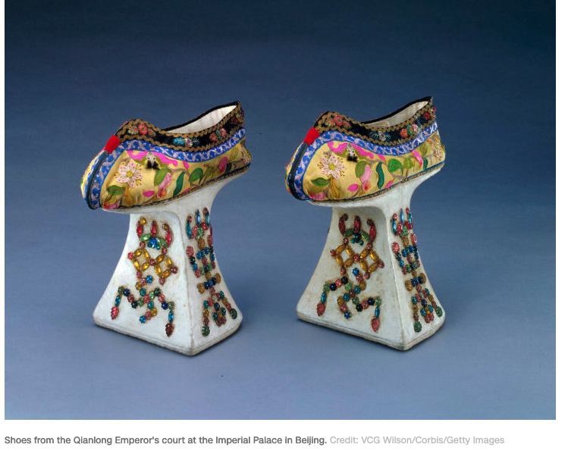
Thanks!

