Slide 1
Human Rights Responsibilities of Social Media Companies and Regulation/Moderation of Content: Markets, Monitoring, Accountability Larry Catá Backer Coalition for Peace & Ethics; Pennsylvania State University
Roundtable on Human Rights and the Business of Social Media
Monday, 25 June 2018
Sponsored by City University of Hong Kong; Human Rights and Policy Forum

Slide 2
Information/Interaction as Service and Commodity
The internet’s grand bargain has long been trading privacy for convenience.
free services like email, entertainment and search,
In return they collect data and sell advertising.

Slide 3
From Internet Quizzes to Analytics: Facebook-Cambridge Analytics—Power of Data Driven Algorithms
Before the 2016 election, Cambridge Analytica was an obscure consulting company funded by the family of conservative hedge fund mogul—and Republican political donor—Robert Mercer. But in the weeks after the 2016 election, rumors began to circulate that Cambridge had played a key role in Donald Trump's victory.
Where conventional political advertising uses crude demographic factors like age and ZIP code to target advertising, Cambridge supposedly used a technique called psychographics, which involves building a detailed psychological profile of a user that will allow a campaign to predict exactly what kind of appeal will be most likely to convince any particular voter.
Use of APIs to harvest additional data:
Application program interface (API) is a set of routines, protocols, and tools for building software applications. An API specifies how software components should interact.
Developing a quiz to harvest Facebook data; use of Facebook profile.
Data feeds predictive algorithms that can be used to shape company action

Slide 4
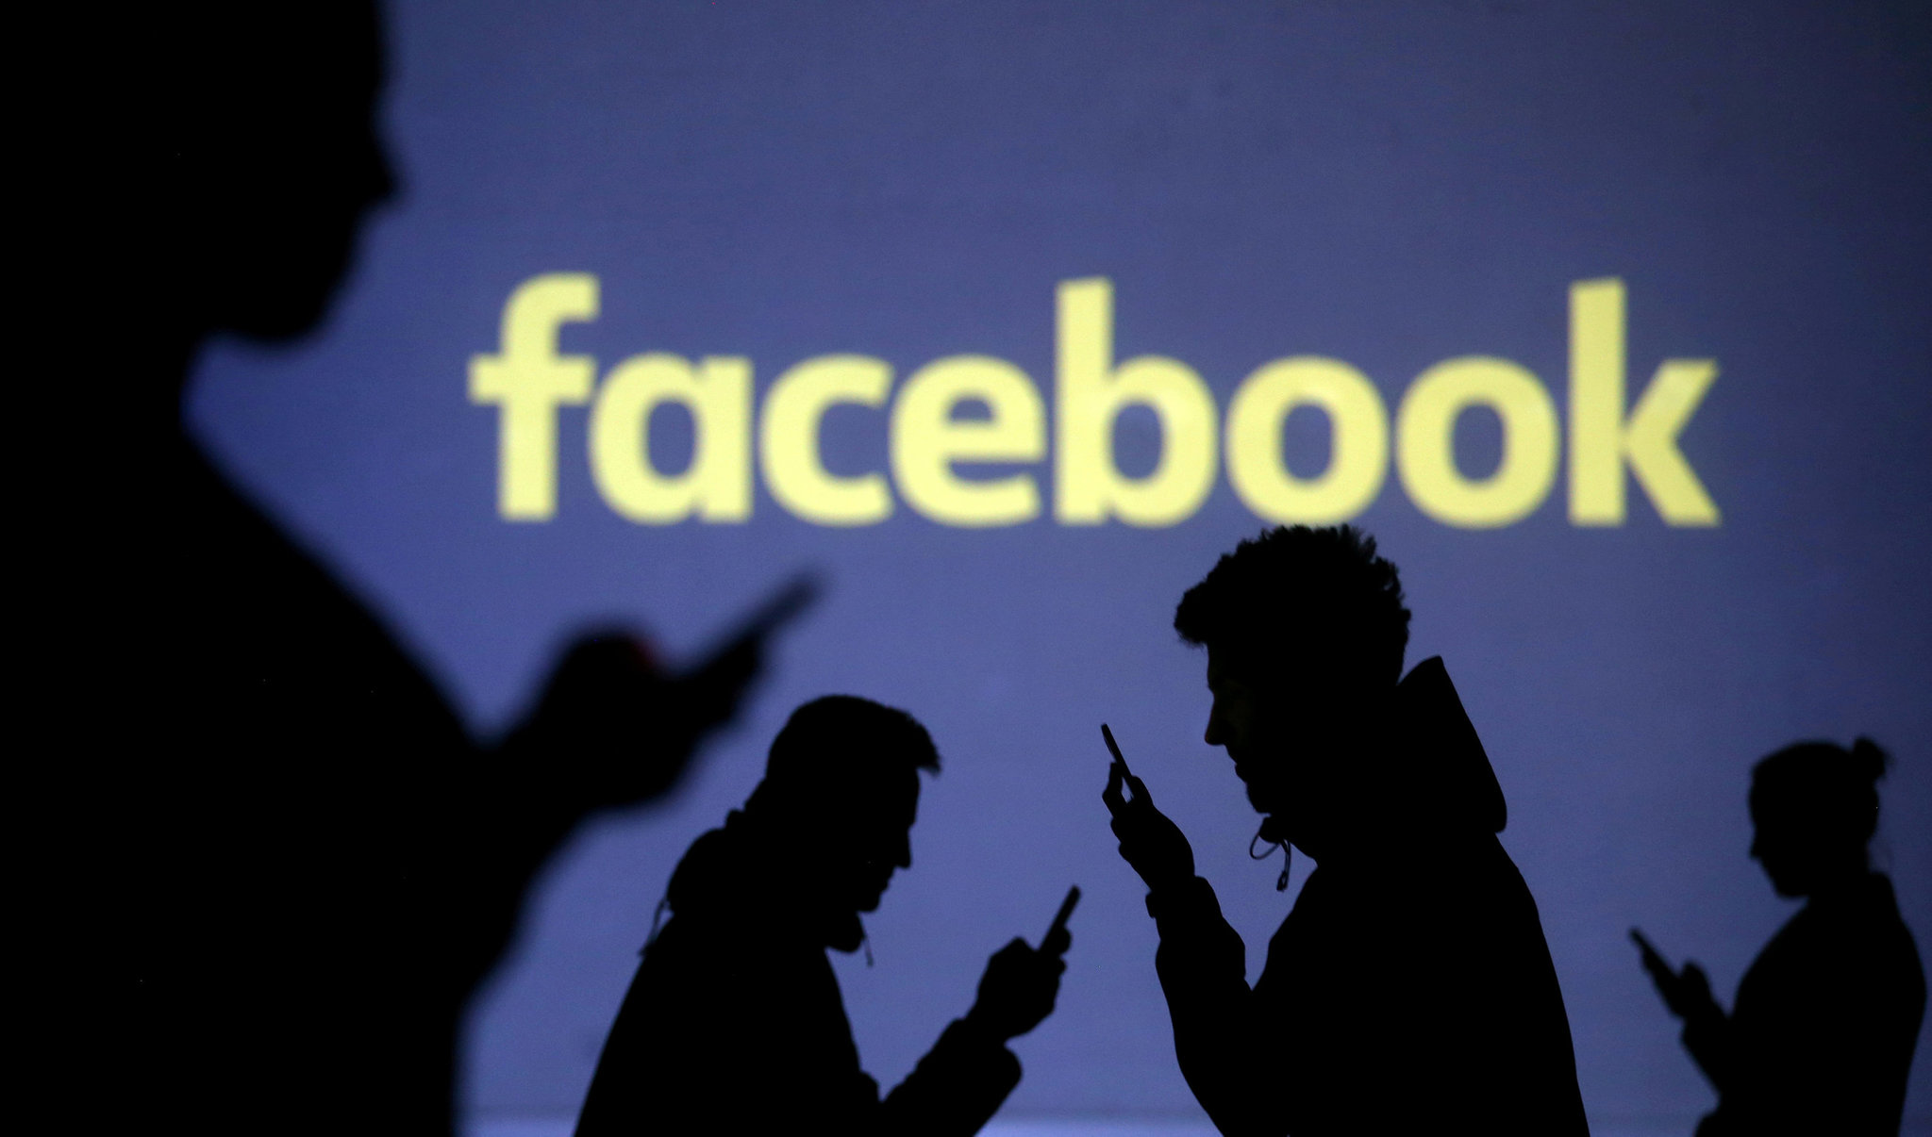
Revenge Porn:
Social media company roles
Protectors against bullying
As repositories of information whose distribution they manage
Facebook Policy
People submit their relationship pictures of an intimate nature
These are reduced to code
When code for these pix appear elsewhere they are blocked
To work everyone must submit their intimate pict8res of any kind to Facebook
Issues
Access
Control
Use

Slide 5
From Information to Politics to Regulation
Social media companies at the center of law, politics and society
Tool of state for control; it’s politics
Tool of enterprises for data harvesting; its business
Surveillance/accountability mechanism,
It0s risk management and social control
Control of social media mirrors current global battles over management discursive space
Data
Personal autonomy
Efficient governance
Risk management
Accountability
Responsibility
Scandals
Use of data by social media companies and others
Integrity of data
Snooping
use of data or postings aggressively by 3trd parties (private or public)
Inflammatory postings
False news
Insults to religion, ethnic communities

Slide 6
From Politics to Governance
State Duty
Censorship
Access to data
Control of data
Corporate Responsibility
Protection of rights of individual users
Coordination with State
Managing Discursive Space
Managing Discursive space
Rule of law

Slide 7
Duty
Disclosure
UK Modern Slavery
French Supply Chain Due Diligence
Conventional disclosures under securities laws
Tort Actions
Monitoring and application of standards
Legal standards
Community standards
Constitutional & statutory rights to expression
Property
Regulatory Schemes
U.S.
E.U. General Data Protection Regulation, also known as the G.D.P.R.

Slide 8
Responsibility
UN Guiding Principles 2nd Pillar
OECD Guidelines for Multinational Enterprises
OECD Principles of Corporate Governance and SOE Governance
Internal Standards
Contract for data

Slide 9
Intersections
Law Enforcement
Method
Alternative to administrative regulation as a tool of lawmaking
Transparency
Engagement
For governance
Information
For consumer choice
Controlling behavior
Organizations
Individuals
Shaping culture
Health and wellness
Social vices (drinking, sexual activity, etc.)
Accountability
Individuals
Entities
government
Social harmony

Slide 10
The Role of Social Media in Promoting Human Rights
Objects
News/journalism
Human rights defenders
Enterprises
The State
Actions
Monitoring
Reporting
Mediating
Data integrity
Privacy

Slide 11
Whose rights?: A Functional Analysis
Monitoring
Employer
State
Trolling
Bullying
Analytics
Search Engines
Google scholar
Political speech
People
Enterprises
Civil society
Labor
Libel-Defamation
False news
Protection of value of image
Outrages to Community sensibilities
Religion
Gender(Sexual orientation/gender Identity
Ethnicity
Etc.

Slide 12
Human Rights Due Diligence
Identify objects
Identify range of human rights actions
Monitoring
Reporting
HRDD context matters
Protecting social space
Engaged in markets for Information
Using information for one’s own account
Balancing human rights effects (Employers versus Employees; etc.).

Slide 13
Mapping Human Rights Responsibilities
Responsibility to whom?
The State
Contributors
Readers
Customers
For What
Content
Privacy
Interactivity
Effects
Security /Collective)
Harm (individual)
Over What
Persons (Social media as communities)
Information (Social media as the producer of goods)
Interactions (social media as amarket)

Slide 14
Example: The Problem of Election Integrity
Sept 2017: Facebook agreed to provide information to U.S. Congressional investigators on advertising purchased by Russian-linked accounts seeking to influence the 2016 U.S. presidential campaign.
Institute for Human Rights and Business; Could UNGP Human Rights Due Diligence Mitigated Risk?
Noted Existing multi-stakeholder platforms like the Global Network Initiative (GNI), which aims to advance freedom of expression and privacy in the Information and Communications Technology (ICT) industry, could be helpful in this process.
“After all, selling ads seeking to shape public opinion on political issues or candidates is not the same as selling soap.”
Use algorithms plus public complaint to manage issue
But complications of interpretation:
“Voters should be able to form opinions independently, free of violence or threat of violence, compulsion, inducement or manipulative interference of any kind.”
All speech may have elements of each of these cautions
A disclosure or participation issue?
Payment for political advertising problematic generally?
Foreign influence?
Should Facebook be given the power to decide?

Slide 15
Beyond Human Rights Due Diligence: Private Governance and Algorithm
Third party standards and self regulation, and the discipline of shareholder activism (regulatory governance mechanics).
Incorporate international standards through 3rd Party rankings
Self discipline through market mechanisms
Internal regulation along social media production chain
Problem of the generation and application of standards.
Example: Reporting on social media posts to the state
combatting terrorism and lawlessness?
Infringing on privacy rights and free expression?
It is all in the standards
Shi Tao Case “Yahoo! Accused of Helping China Convict Journalists
Following Chinese law or upholding an interpretation of ICCPR
Well treated in Erika George: Corporate Social Responsibility And Social Media Corporations: Incorporating Human Rights Through Rankings, Self-regulation and Shareholder Resolutions (Duke J. Comp. & Int´l Law 2018).

Slide 16
Mechanics: Getting the algorithm Right
“Content flagged as violent — a beating or beheading — may be newsworthy. Content flagged as “pornographic” might be political in nature, or as innocent as breastfeeding or sunbathing. (…) Meanwhile content that may not explicitly violate rules is sometimes posted by users to perpetrate abuse or vendettas, terrorize political opponents, or out sex workers or trans people.” (The Chilling Effects of Content Policing by Social Media, Pieter-Jan Ombelet - 05 July 2016)

Slide 17
Challenges For Human Rights Responsibilities of Social Media Companies and Regulation/Moderation of Content
Multiple objectives
Content policing
Reporting to state and non state organs
Sale of information
Use of social media to generate data for third parties or one’s own account
Integrity of political process
Managing international and local standards for social stability
Trolling and harassment
Multiple standards Law
Industry governance
Self governance
Third party sources
Multiple mechanics
Rankings
Accountability mechanisms
Regulation
Markets
Challenges
Standard setting is problematic
Context matters
Political versus economic versus social objectives
Complication from character of social media as a business, as a tool, and as a community space.
Algorithms

Slide 18
The Future?
Matrix of regimes for HRDD
Content: Focus on information and its production
Distribution: Focus on individuals and use

Slide 19
Thanks

